Slide 1
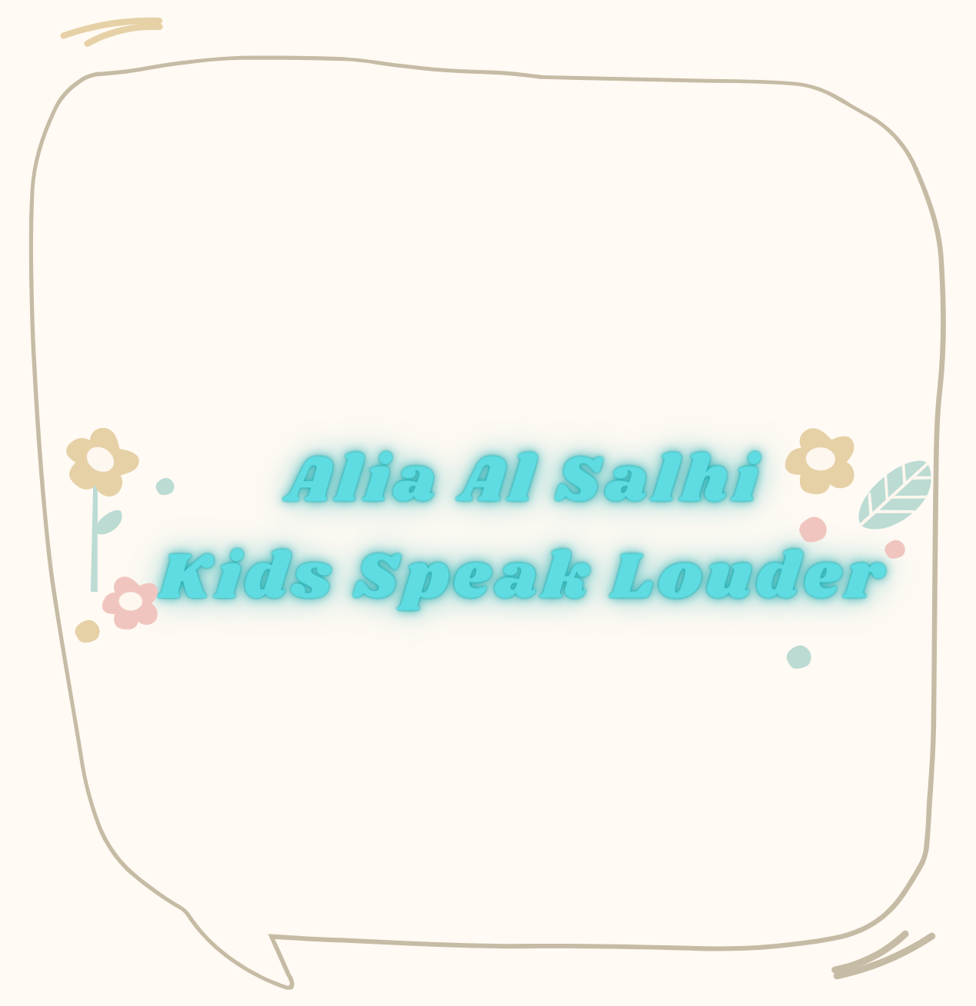


Slide 2
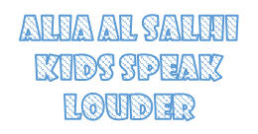


Hit the target
Alia Al Salhi
Kids Speak Louder

Slide 3
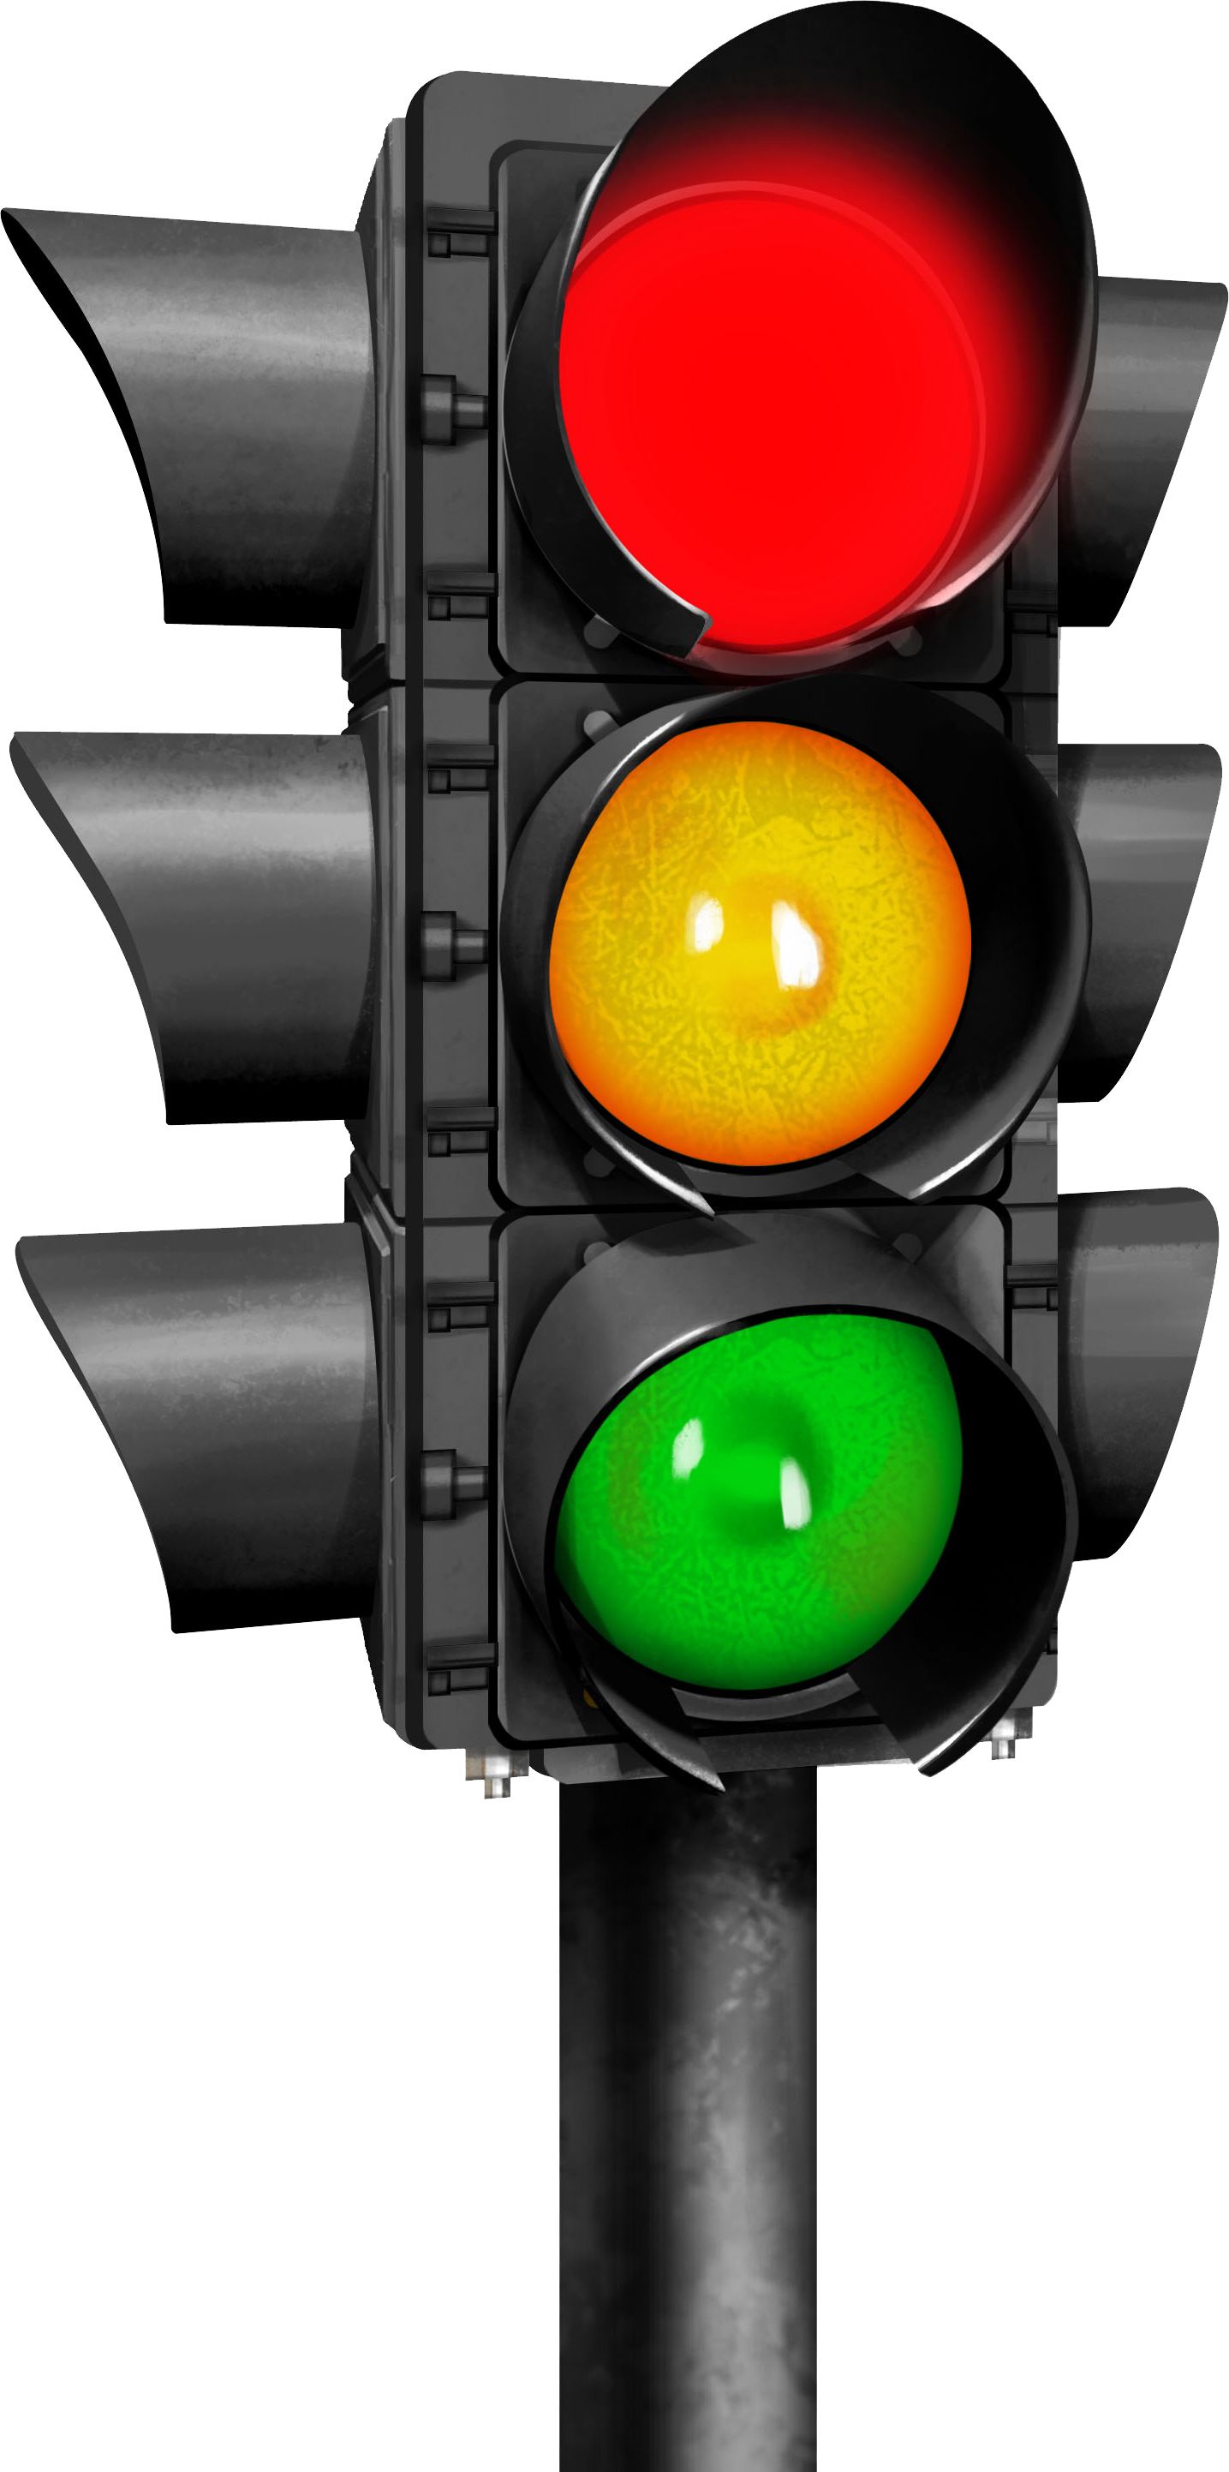

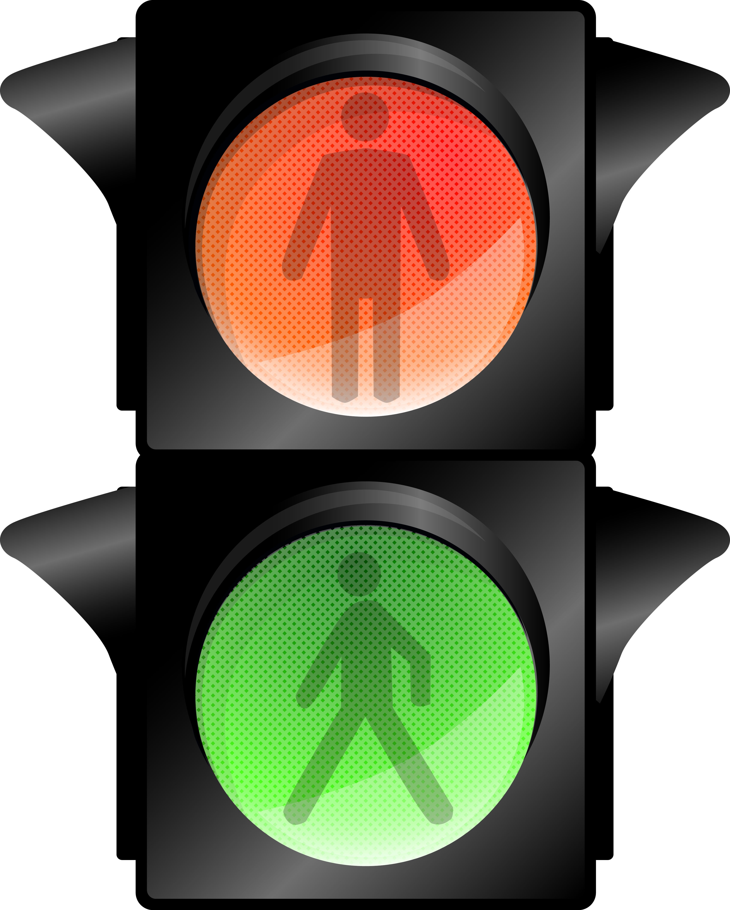
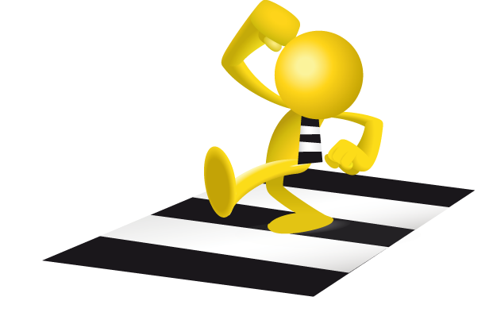
This is for cars to go or stop
Alia Al Salhi
Kids Speak Louder

Slide 4
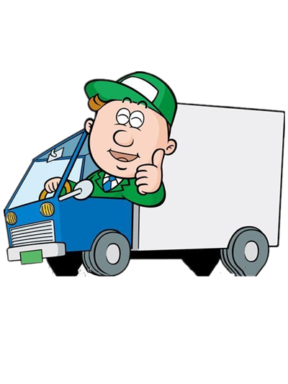
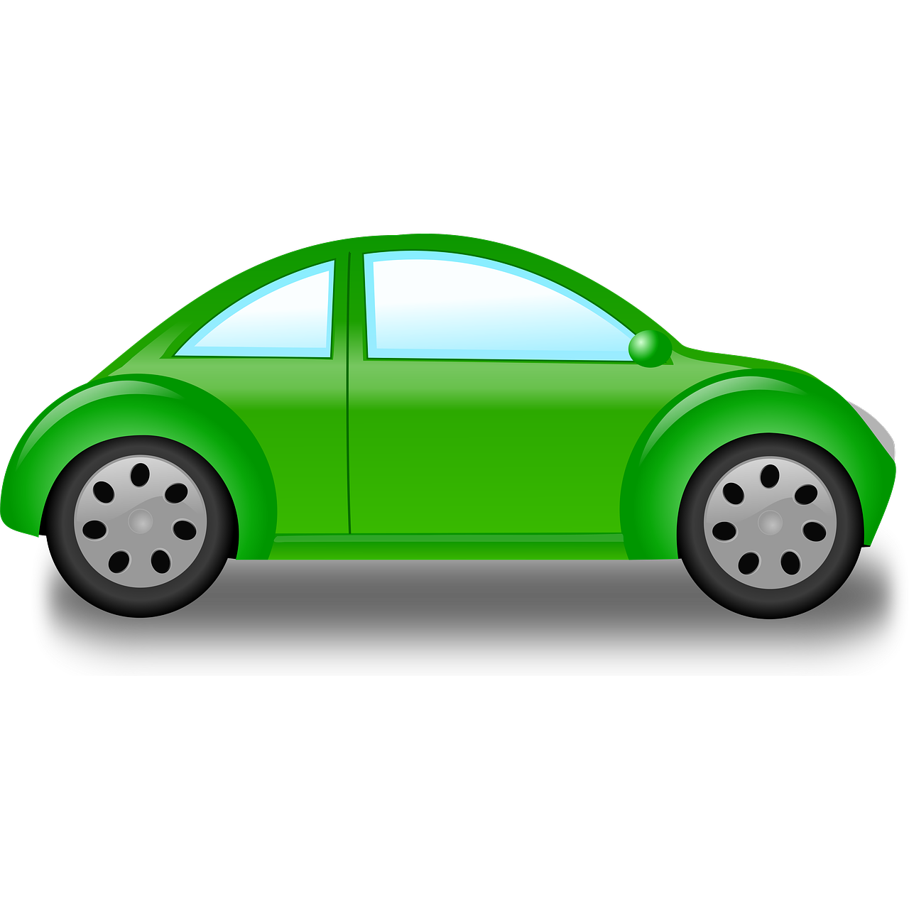
This is for pedestrians
Alia Al Salhi
Kids Speak Louder

Slide 5
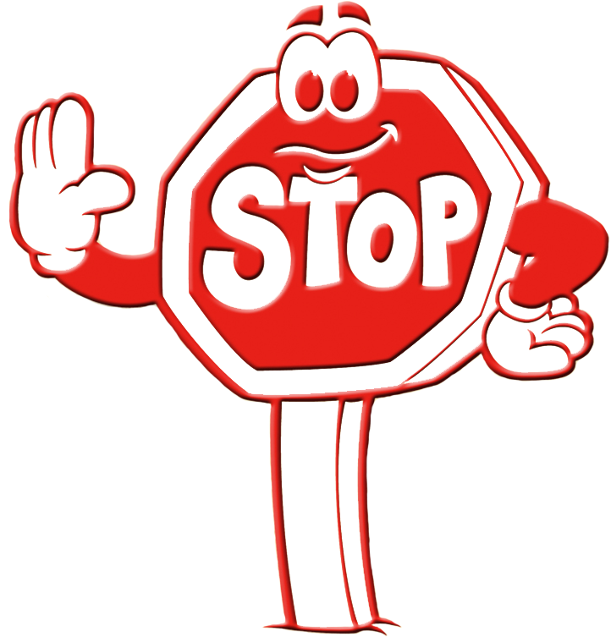
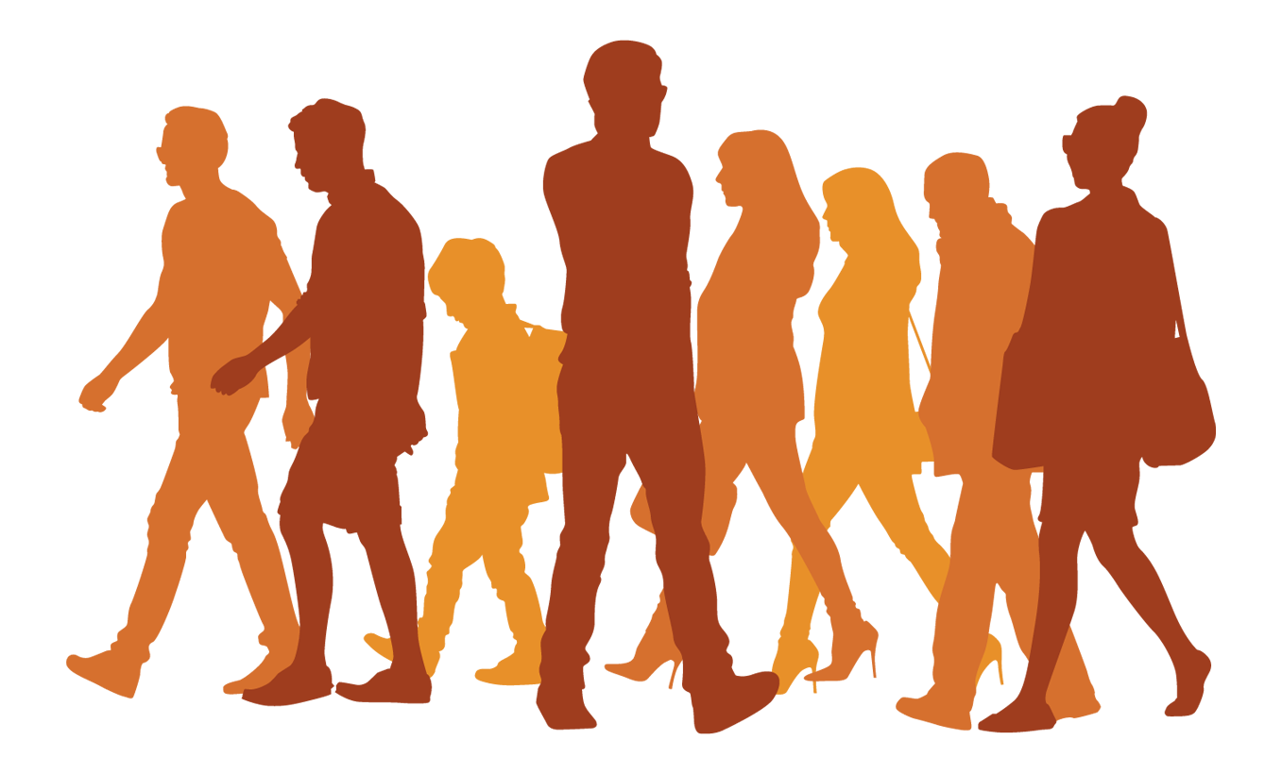
Pedestrians
Alia Al Salhi
Kids Speak Louder

Slide 6

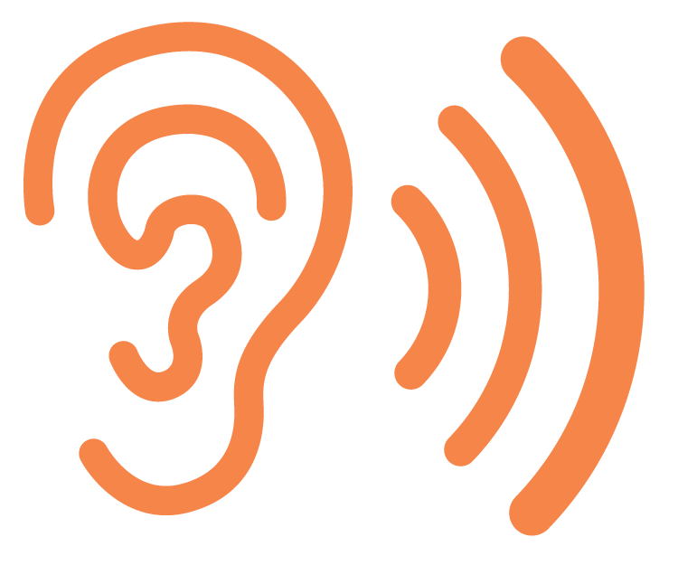

Stop
Alia Al Salhi
Kids Speak Louder

Slide 7
Look
Alia Al Salhi
Kids Speak Louder

Slide 8
Listen
Alia Al Salhi
Kids Speak Louder

Slide 9

I cross the road at the……
Alia Al Salhi
Kids Speak Louder

Slide 10
Red light means …
stop
careful
Go
Alia Al Salhi
Kids Speak Louder

Slide 11
Green light means….
stop
careful
Go
Alia Al Salhi
Kids Speak Louder

Slide 12
Yellow light means….
stop
careful
Go
Alia Al Salhi
Kids Speak Louder

