Slide 1
Alia Al Salhi
Kids Speak Louder

Slide 2
In this game students will practice answering questions about careers.
اكتب السؤال هُنا
Teacher will ask the student to choose a ball by asking:
Which ball would you like to choose?
الإجابة
And they will practice to choose a color of a ball by saying for example:
اكتب الإجابة هنا
I`d like to choose the red ball.

Slide 3
في هذه اللعبة سوف يتعلم الطالب الإجابة عن أسئلة حول المهن.
اكتب السؤال هُنا
المعلمة سوف تطلب من الطالب أن يختار كرة عن طريق سؤاله:
Which ball would you like to choose?
الإجابة
سوف يتدرب على إختيار لون الكرة عن طريق استخدام هذه الاجابة .مثلا:
اكتب الإجابة هنا
I`d like to choose the red ball.

Slide 5
What does a carpenter do ?
He makes
furniture out of wood.
Answer
Back

Slide 6
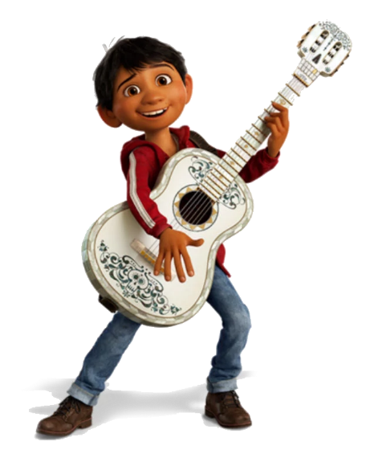
Who plays music?
The musician plays music.
Answer
Back

Slide 7
What does a cook do?
He cooks food in a restaurant.
Answer
Back

Slide 8
Hard Luck.
Back

Slide 9
Hard Luck.
Back

Slide 10
What does the pilot do?
He flies a plane.
Answer
Back

Slide 11
Hard Luck.
Back

Slide 12
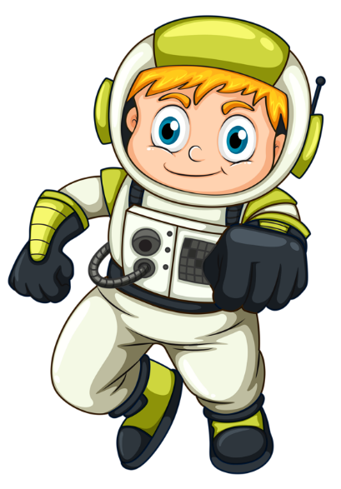
Who travels in a spaceship?
The astronaut travels in a spaceship.
Answer
Back

Slide 13
What does a basketball player do?
He plays basketball in a team.
Answer
Back

Slide 14
Who makes
furniture out of wood?
The carpenter makes furniture out of wood.
Answer
Back

Slide 15
Who takes care of sick people?
The doctor takes care of sick people.
Answer
Back

Slide 16
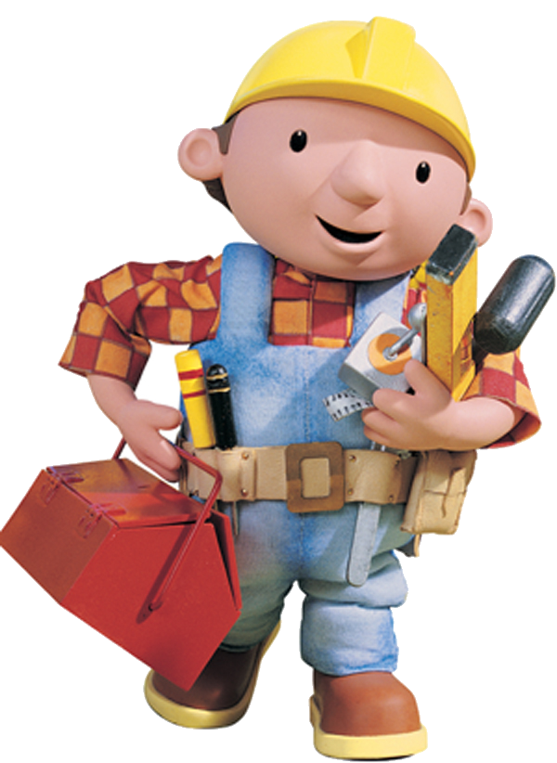
Who builds a wall with bricks?
The builder builds a wall with bricks.
Answer
Back

Slide 17
What does a musician do?
He plays music.
Answer
Back

Slide 18
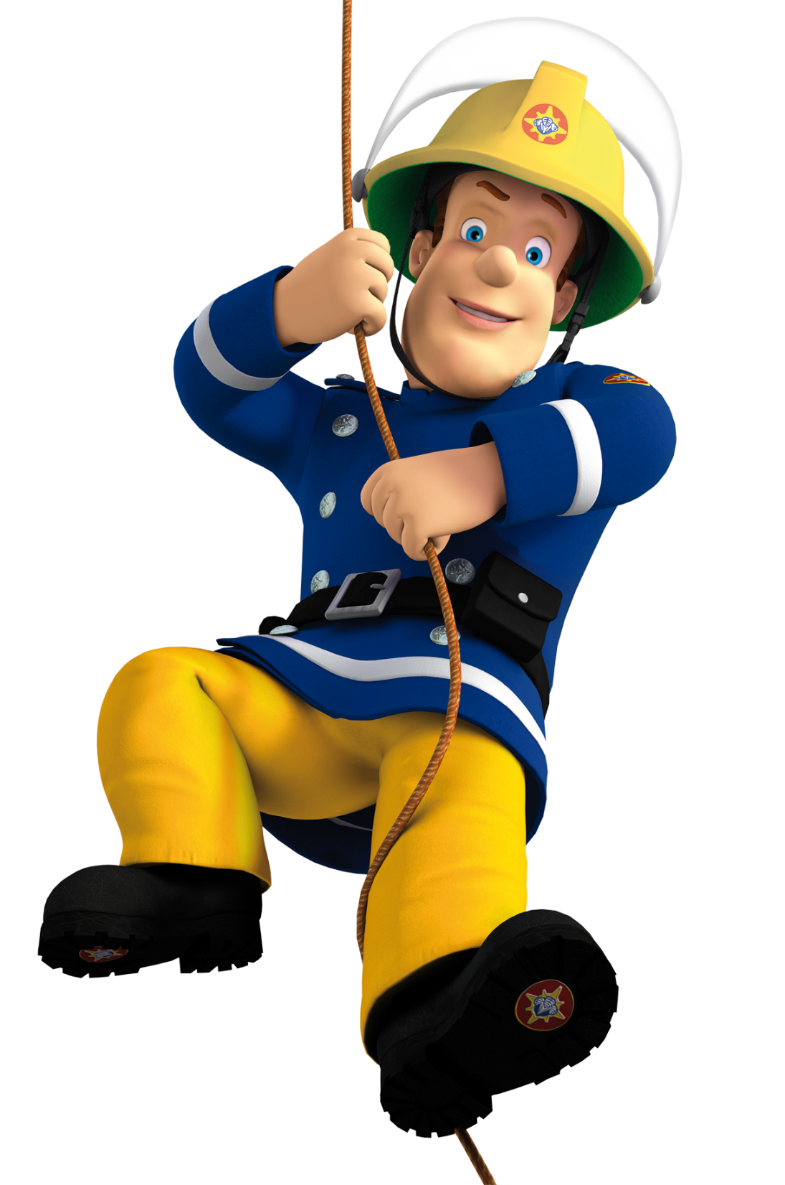
What does the fireman do ?
He puts out the fire.
Answer
Back

Slide 19
Who plays in a team?
A basketball player plays in a team.
Answer
Back

Slide 20
Who flies a plane?
The pilot flies a plane.
Answer
Back

Slide 21
What does a mechanical engineer do ?
He mends the machine.
Answer
Back

Slide 22
What does the doctor do?
He takes care of sick people.
Answer
Back

Slide 23
Who cooks food in a restaurant?
A cook cooks food in a restaurant.
Answer
Back

Slide 24
Who makes experiments?
The chemist makes experiments.
Answer
Back

Slide 25
Who puts out the fire?
The fireman puts out the fire.
Answer
Back

Slide 26
What does the astronaut do?
He travels in a spaceship.
Answer
Back

Slide 27
What does a builder do?
He builds a wall with bricks.
Answer
Back

Slide 28
Who mends the machine?
The mechanical engineer mends the machine.
Answer
Back

Slide 29
What does a chemist do?
He makes experiments in the lab.
Answer
Back

Slide 30
Hard Luck.
Back

Slide 31
Well Done
اكتب السؤال هُنا
الإجابة
اكتب الإجابة هنا
Back

